Slide 1
VU lambda load Test aws vs gcp
Bingxuan Ying (AWS) / Mesh (GCP)

Slide 2
Quick intro
We will do a load test on lambda services provided by AWS vs. GCP.
Two HTTP calls will be applied: GET, POST.
Bingxuan Ying will be responsible of AWS part.
Mesh will do the GCP part.
We will use the “Load testing a web application’s serverless backend” Article as reference, but test on different loads.

Slide 3
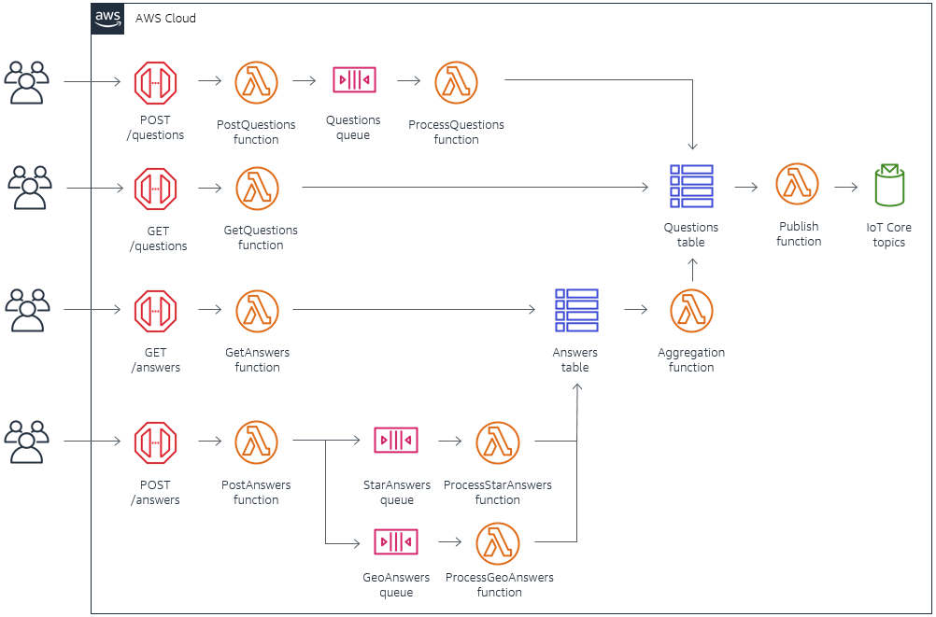
Basic Idea
GET Request: once the lambda service receives the GET request, it will store the data to Aurora RDS.
POST Request: once the lambda service receives the POST request, it will fetch data from Aurora RDS and return it to users.
We are going to make incremental requests to the Lambda service and record the metric.

Slide 4
Metric details
Min response time
Max response time
Median response time

Slide 5
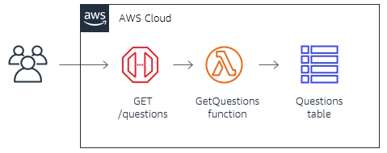
Test Environment
GET
Lambda Runtime: Nodejs 14.x
Database: Aurora RDS
Request Script: Run on Cloud9
I decided to run everything on AWS to prevent the test from being affected by machine performance or networking issues.
POST

Slide 6
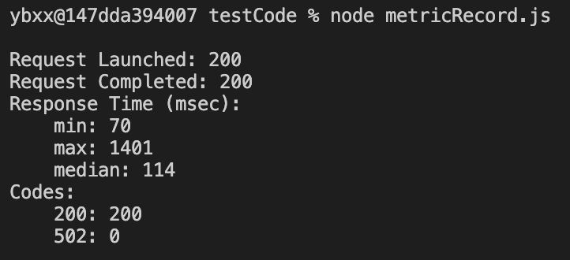
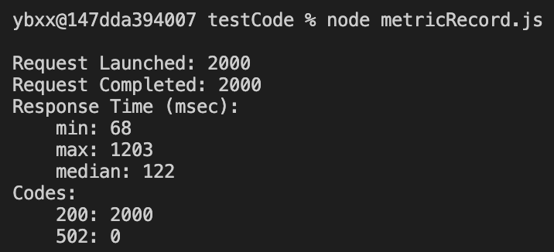
results

